Slide 1
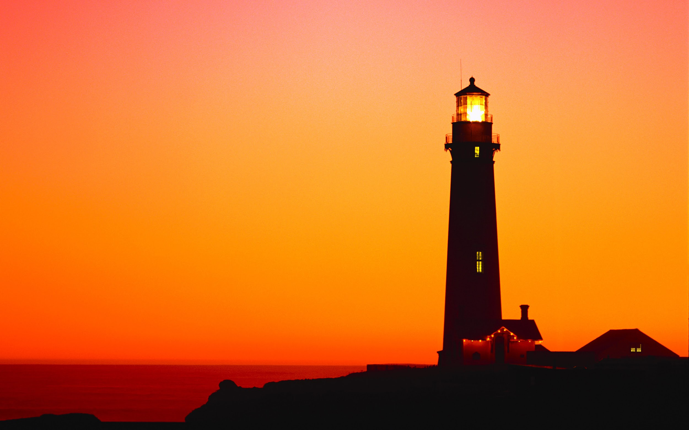
Beaconn
To spark Activity in Communities around the world
Team 16
Michael Bezzina - Front-End specialist
Chris Huffman - Database developer
Alexandra Koudele - Database developer
Frank Mukendi - Google Maps API specialist
David Munson - Full Stack developer
Chandler Samuels- Full Stack developer
Event/Meeting planning & organization service

